Slide 1
Easter 4
Spiritual exercises for Easter
Lost and Found
Rev Julia Monaghan

Slide 2
Lost and Found
This week I lost my John Lewis credit card. I searched high and low, in all the usual places, but I couldn’t find it anywhere. By Wednesday, I phoned to cancel the card and after negotiating the automated Covid notice, I was straight through to an operative, asking my name, date of birth and the second and fifth letter of my ‘safe word,’ (like I can ever remember that!)
Security over I reported my lost card. There was silence on the other end of the phone, and the voice then said, “Well, how did you do that then? I mean, it’s not like you’ve gone out or anything is it? You couldn’t have dropped it on the underground, or had it stolen when you were buying a coffee? And, nobodies been to the house, have they? It isn’t like you can blame it on your older children calling. That they came by and picked it

Slide 3
by accident, because they haven’t called have they. No, so if you didn’t lose it outside and you didn’t lose it inside, there is only one thing for it then……It’s the house goblins, isn’t it! They come in and disturb your peace of mind”
“Well, yes,” I stammered, “it must be.”
“Exactly,” she said with increased pitch and excitement “So when I push the button to cancel your card, the chances are it will be found …..just like that! So, what do you want me to do, my finger is hovering over the button. It’s hovering!”
I said, “Hmmmm……….Your home working today aren’t you?”

Slide 4
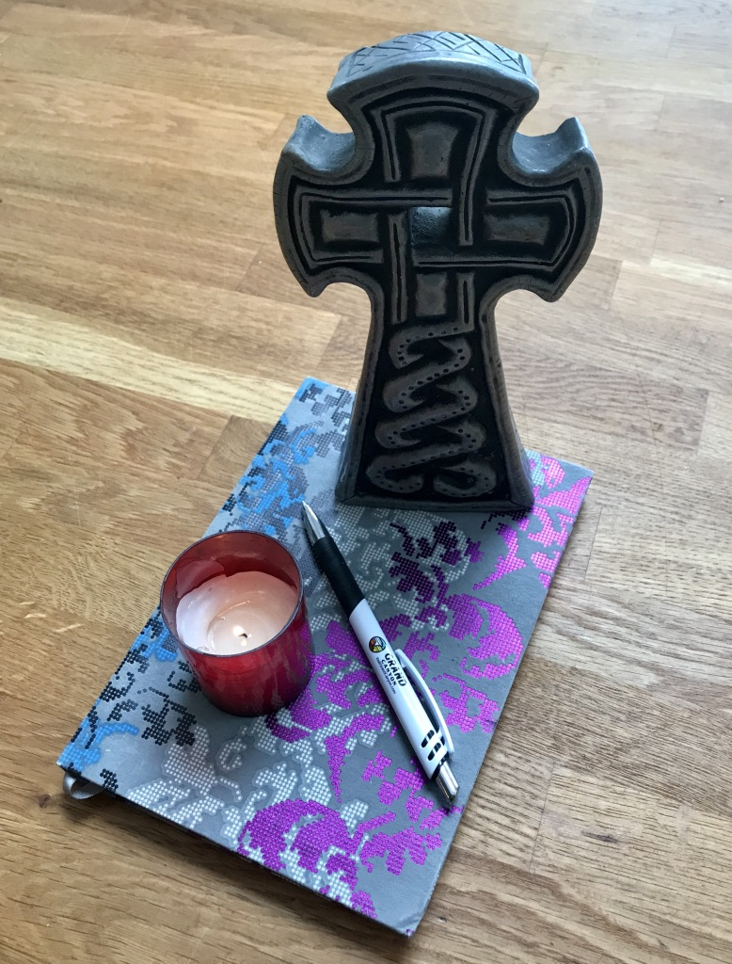
At that, she took a breath, cancelled the card and ordered a new one. I went to make a coffee and unload the dishwasher and as I did, I put my hand in my apron pocket, and there it was, my John Lewis credit card! It was truly the house goblins!
So what’s lost and found with you this week? Where have the house goblins been at work, stealing your peace of mind, your Easter Joy?
I would like you to take a piece of paper and name the institutions, attitudes, people, anything that has robbed you of your joy this week. Light a candle and offer all these areas of life to God ,in a prayer of confession that we let such things steal our peace and sense of well being, and ask again to receive Jesus’ promise of abundant life.

Slide 5
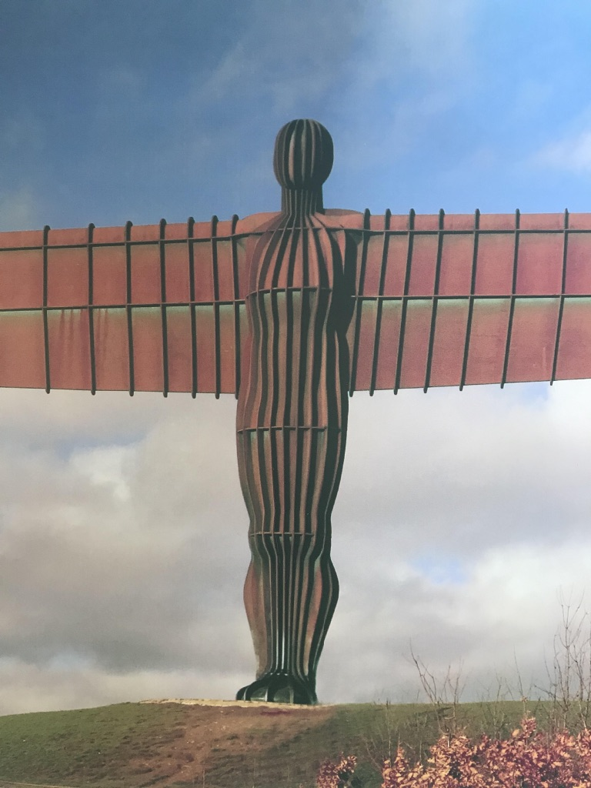
Good Shepherd Sunday
The lectionary names this Sunday, Good Shepherd Sunday, with a series of readings from Psalm 23, through to John 10, where Christ is described as the Good Shepherd, who knows and calls his own sheep by name and they in turn recognise his voice and follow him. The readings picture the marvellous and familiar relationship of trust that the sheep exhibits towards the shepherd.
Helpless and vulnerable, they depend on the shepherd for nourishment, protection and guidance. When they are lost and under threat it is the shepherd who places himself between the dependent sheep and aggressive enemy, to ward off destruction and exploitation. The psalmist, puts words in the mouths of the sheep,
“You are with me; your rod, staff - they comfort me.”

Slide 6
Lectio Divina
Meditate on John 10
Reflect
Respond
Rest
Read
Read through quietly and prayerfully John 10 1-10, as it would be read aloud slowly as it would once have been read in the monastery. Pay attention to which individual word resonates or strikes a chord with you. Read John 10 slowly with a pause at the end of each verse. Leave a minutes silence after the end and then read it again in the same way. Repeat a third time. Carry with you the words that stood out for you, returning to them again and again over the course of the day.
Mind
Body
Heart
Spirit

Slide 7
John 10: 1-10
10 “Very truly, I tell you, anyone who does not enter the sheepfold by the gate but climbs in by another way is a thief and a bandit. ² The one who enters by the gate is the shepherd of the sheep. ³ The gatekeeper opens the gate for him, and the sheep hear his voice. He calls his own sheep by name and leads them out. ⁴ When he has brought out all his own, he goes ahead of them, and the sheep follow him because they know his voice. ⁵ They will not follow a stranger, but they will run from him because they do not know the voice of strangers.” .

Slide 8
⁶ Jesus used this figure of speech with them, but they did not understand what he was saying to them
⁷ So again Jesus said to them, “Very truly, I tell you, I am the gate for the sheep. ⁸ All who came before me are thieves and bandits; but the sheep did not listen to them. ⁹ I am the gate. Whoever enters by me will be saved, and will come in and go out and find pasture. ¹⁰ The thief comes only to steal and kill and destroy. I came that they may have life, and have it abundantly.

Slide 9

And finally, find a version of the 23rd psalm to listen to in song.
Stuart Townend 23rd Psalm
https://youtu.be/pN4tPkX0MGO
Vicar of Dibley version
David Goodall
https://youtu.be/yLxdb3ov-zE
Prayer
For the gift of salvation,
For your presence in our lives,
For the security you offer us,
For your life that enriches our life,
For the sense of belonging,
For our place in your sheepfold,
Great Shepherd of the sheep
We praise and adore you. Amen
Rev Julia April 2020

Slide 10
Amen

