Slide 1
Easter 6
Spiritual exercises for Easter
United by Love
Rev Julia Monaghan

Slide 2
The Promise of the Holy Spirit
Look at the Wordle opposite which highlights many names for the Holy Spirit, and think about, which of these, or any other names for the Spirit, you find most helpful. Why might that be?
The 6th Week of Easter marks a transition point. So far, we have been looking at the Easter story through the resurrection appearances to the disciples and then, through the Gospel of John, we have been looking at the eternal character and nature of the Risen Christ. He has been described as The Good Shepherd, The Way, the Truth and the Life.
baptise
dove
pentacost
counsellor
paraclete
Holy Spirit
fire
advocate
wind
tongues
power
anoint

Slide 3
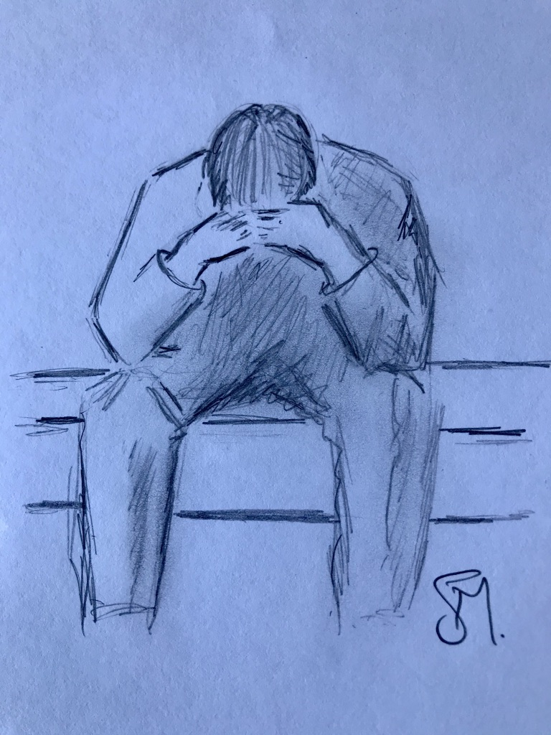
In the 6th week of Easter, the emotional temperature changes as Jesus begins to prepare his disciples for his departure, Ascension Day is next Thursday. In their grief, he seeks to reassure them. Though they will feel bereft, he is not abandoning them, they will not be ’orphaned,’ (John 14: 18).
The Holy Spirit, the Advocate, the true comforter, will live in them as he lives in the Father, and he goes on to describe a mutual abiding in eternal relationship.

Slide 4
Read John 14: 15-21
¹⁵ “If you love me, you will keep^{[a]} my commandments. ¹⁶ And I will ask the Father, and he will give you another Advocate,^{[b]} to be with you forever. ¹⁷ This is the Spirit of truth, whom the world cannot receive, because it neither sees him nor knows him. You know him, because he abides with you, and he will be in^{[c]} you.
¹⁸ “I will not leave you orphaned; I am coming to you. ¹⁹ In a little while the world will no longer see me, but you will see me; because I live, you also will live. ²⁰ On that day you will know that I am in my Father, and you in me, and I in you. ²¹ They who have my commandments and keep them are those who love me; and those who love me will be loved by my Father, and I will love them and reveal myself to them.”

Slide 5
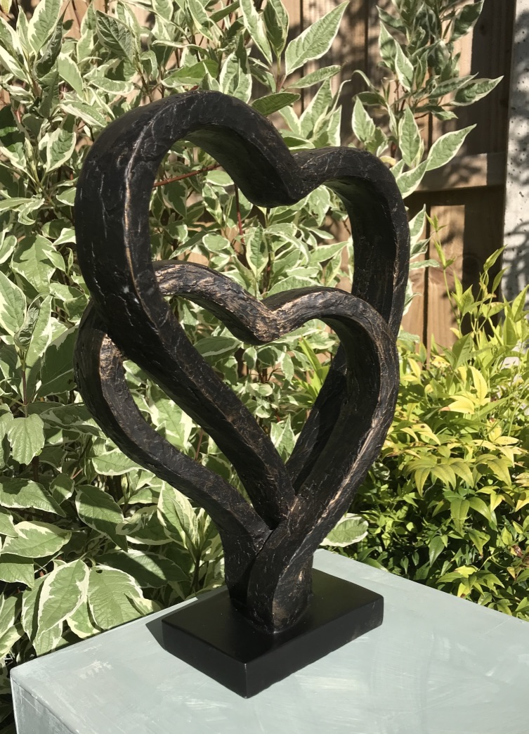
Know yourself deeply loved
I don’t know about you, but this week, has been a funny old week. We have been in a period of transition with some lock down regulations easing and a road map for the future being provided, yet for some of us, its carried on in the, same old same old, as we continue to be shielded. We have a creeping fear that this could be the start of us being left behind. So Jesus’ words speak directly to us, left behind may be, but NEVER abandoned – or in his words ‘orphaned.’ The Spirit comes to bind us together in abiding relationship with him, and with one another.
Look at the sculpture from my garden opposite and reflect on what it means to be deeply loved by God? Do you know yourself deeply loved by God?

Slide 6
Jesus Commissions Us
We believe in God, in Jesus Christ, in the Holy Spirit
And in you and me.
We believe that the Holy Spirit has freed us to worship as a community united by love.
We believe that the Holy Spirit works through
-Reconnection with old friends, through the phone, email and zoom.
-Photos of loved ones, and the time to look through an album of past celebrations together.
-Sharing our appreciation through applause on our doorstep
-Remembering those who have died and those who grieve for them
-Speaking out for those whose plight is unheard at this time of emergency
-New ways of being a mission focused church without walls
We believe in praising God for life
We believe in words of forgiveness
We believe in responding to God’s grace and love and justice for all people
We believe in the poetry within each of us.
We believe in dreams and visions.
We believe in the Kingdom of God within us. Amen
On the evening when Jesus spoke to his disciples of his abiding love, he also commissioned them. Instead of looking wistfully, nostalgically back to what they had experienced before with him, he encouraged them to look forward and outward.
He said that if they loved him, they needed to keep his commandments. He is asking them to embrace the love that he had lived among them. He wants his disciples, his community, his church to act from a place of love and mercy.
Think of 3 ways, you can put this command into action this coming week, whatever your current circumstances. Jesus still has work for you to do.
Close by praying the Affirmation of Faith opposite.

Slide 7
Amen

