Slide 1
Ordinary Time 12
Spiritual exercises 21st June 2020
Separation for Growth
Rev Julia Monaghan

Slide 2
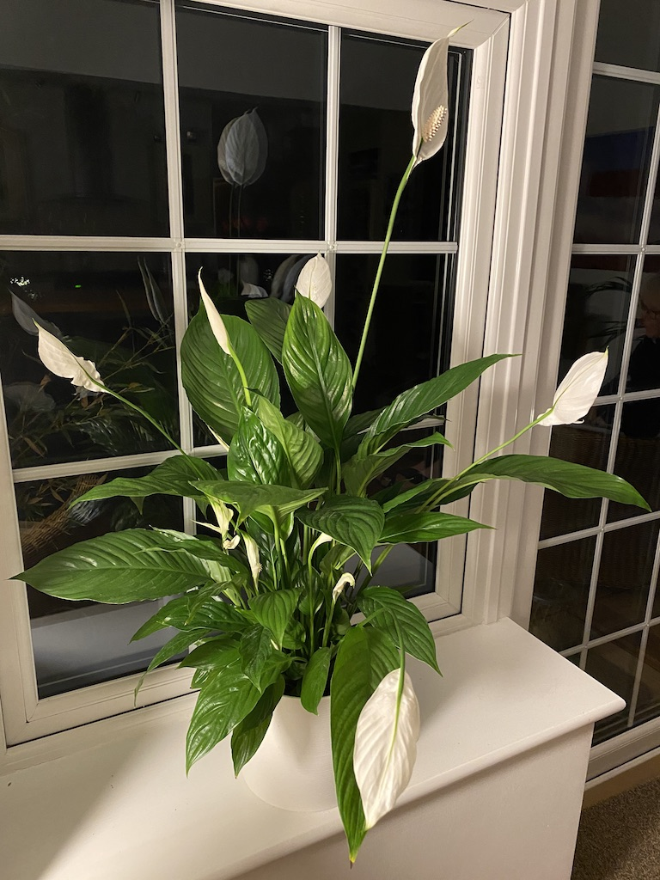
Dividing and Separating my Peace Lilly.
I’ve got my beautiful ‘Peace Lily’ here, with its lush foliage and iconic white flowers, and I’m dividing and separating it this morning, to form 2 plants. I am hoping to keep one and give the other one to my Dad for Father’s Day.
The work of separation, is at the heart of our gospel reading this week and its not one of Jesus’ most palatable and easy to take teachings. Some what contrary to his identity as ‘The Prince of Peace,’ (Isaiah 9:6), he says ’….I have not come to bring peace but a sword..’
He then goes on to expand the consequences of his role and actions. You are invited to read the full text on the following slide.

Slide 3
Matthew 10: 34-39
³⁴ “Do not think that I have come to bring peace to the earth; I have not come to bring peace, but a sword.
³⁵ For I have come to set a man against his father, and a daughter against her mother, and a daughter-in-law against her mother-in-law; ³⁶ and one’s foes will be members of one’s own household
³⁷ Whoever loves father or mother more than me is not worthy of me; and whoever loves son or daughter more than me is not worthy of me; ³⁸ and whoever does not take up the cross and follow me is not worthy of me. ³⁹ Those who find their life will lose it, and those who lose their life for my sake will find it”.

Slide 4
Separation is necessary for the creation and flourishing of life. It is at the heart of growing up and becoming more fully ourselves.
Separateness is the freedom to think our own thoughts, hear our own voice, establish our own cares and concerns. As Christians we choose to do that in relationship with Christ. It means discovering for ourselves, our lacks and limitations, our strengths and gifts, our hopes and desires.
The Benedictine Nun of great wisdom, Str Joan Chittister, says that separateness is, ‘the willingness to live inside ourselves rather than to live off the clamour around us.” She goes on to say that it opens us up to the quiet call of ‘Godness within us,’ and is part of the journey to maturation.
(Sr Chittister: Between the Dark and the Daylight: Embracing the Contradictions of Life 2015)

Slide 5
Light a candle and take time to reflect.
From whom or what do you need to separate - not as a rejection of them but as a reclaiming of yourself? Is it a person, voice, fear, past experience?
What do you need to let go of in order to grow and come alive? It could be about an institution; a political idea; the church. Jesus is not about asking us to abandon relationships, but rather re-orientate our lives, to become more fully alive in him.
And maybe the sword of separation needs to be applied to our relationship with God and Jesus? This is not about rejection or turning away, its about creating the space to allow a new understanding, a new God-image to arise within us. If we read and understand the Bible as we did when a child, then something is wrong. What stunted our faith journey and what needs to be relinquished?
From fear of staying still, O God deliver me
From fear of surrender, O God deliver me
From fear of decision, O God deliver me
From fear of losing respect, O God deliver me
From fear of facing me fear, O God deliver me
But from the fear that marks your presence,
I beseech you O God, do not deliver me.
Janet Morley: All Desires Known.
Companion and Guide,
You are my transition coach
Joyce Rupp: Out of the Ordinary
Holy Spirit, Wisdom discerning,
accompany us on the journey,
challenge us with your questioning
unfold the truths that set us free
Jim Cotter: Embracing the Mystery

Slide 6
Amen

