Slide 1
Easter 2
Spiritual exercises for the second week of Easter
From Grief to Joy

Slide 2
The Festival of Easter
Welcome to my kitchen as we move towards the second Sunday of Easter. Here you see my olive tree, that I’ve bought inside and decorated with eggs. It will remain there until Ascension Day. With all the drama and chocolate eating of Easter Day, it’s very easy to forget that Easter is actually a festival of 50 days, from Easter Sunday through to Pentecost. It’s the time when we embed the Easter story within our DNA. What does it mean to live as an Easter people? How do we now relate to God; to ourselves, to each other? The lectionary, the set of stories laid down by the church at this time, comes to our help. They are a rich set of stories full of life giving symbolism and I would like to share one of those with you this week, as we engage in spiritual work together.

Slide 3
Read Luke 24: 13-35
¹³ Now on that same day two of them were going to a village called Emmaus, about seven miles from Jerusalem, ¹⁴ and talking with each other about all these things that had happened. ¹⁵ While they were talking and discussing, Jesus himself came near and went with them, ¹⁶ but their eyes were kept from recognizing him. ¹⁷ And he said to them, “What are you discussing with each other while you walk along?” They stood still, looking sad. ¹⁸ Then one of them, whose name was Cleopas, answered him, “Are you the only stranger in Jerusalem who does not know the things that have taken place there in these days?” ¹⁹ He asked them, “What things?” They replied, “The things about Jesus of Nazareth, who was a prophet mighty in deed and word before God and all the people, ²⁰ and how our chief priests and leaders handed him over to be condemned to death and crucified him. ²¹ But we had hoped that he was the one to redeem Israel. Yes, and besides all this, it is now the third day since these things took place.
We encourage you to look up Janet Brooks-Gerloff’s painting of Emmaus, which we cannot reproduced here for Copyright reasons.

Slide 4
²² Moreover, some women of our group astounded us. They were at the tomb early this morning, ²³ and when they did not find his body there, they came back and told us that they had indeed seen a vision of angels who said that he was alive. ²⁴ Some of those who were with us went to the tomb and found it just as the women had said; but they did not see him.” ²⁵ Then he said to them, “Oh, how foolish you are, and how slow of heart to believe all that the prophets have declared! ²⁶ Was it not necessary that the Messiah^{[e]} should suffer these things and then enter into his glory?” ²⁷ Then beginning with Moses and all the prophets, he interpreted to them the things about himself in all the scriptures.
© images of Sieder Koder’s artworks are copyright and reproduced by permission

Slide 5
²⁸ As they came near the village to which they were going, he walked ahead as if he were going on. ²⁹ But they urged him strongly, saying, “Stay with us, because it is almost evening and the day is now nearly over.” So he went in to stay with them. ³⁰ When he was at the table with them, he took bread, blessed and broke it, and gave it to them. ³¹ Then their eyes were opened, and they recognized him; and he vanished from their sight. ³² They said to each other, “Were not our hearts burning within us^{[f]} while he was talking to us on the road, while he was opening the scriptures to us?” ³³ That same hour they got up and returned to Jerusalem; and they found the eleven and their companions gathered together. ³⁴ They were saying, “The Lord has risen indeed, and he has appeared to Simon!” ³⁵ Then they told what had happened on the road, and how he had been made known to them in the breaking of the bread.
Image Copyright © Trustees for Methodist Church Purposes. The Methodist Church Registered Charity no. 1132208

Slide 6
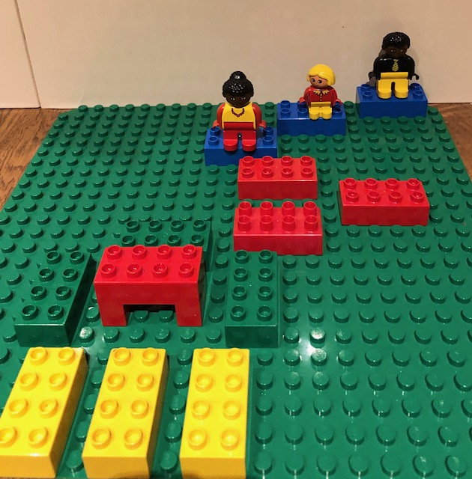
Spiritual Exercise
We are going to use this story to do some spiritual work. If you are fortunate enough to have children in the house, I would like you to take some Duplo/Lego, 3 blue, red, green and yellow bricks and lay them out in a path as shown in the photograph. At the end of the path make a table and place 3 yellow bricks at the end fanning out. Then take as many Duplo/Lego people as you have in your family, plus 1.
This is a listening exercise. Start at the blue bricks and have a conversation with Jesus about what made you feel blue this week. Listen to each other and resist the temptation to jump in an sort. Move to the red bricks and talk about what made you feel angry this week. Again just listen.

Slide 7
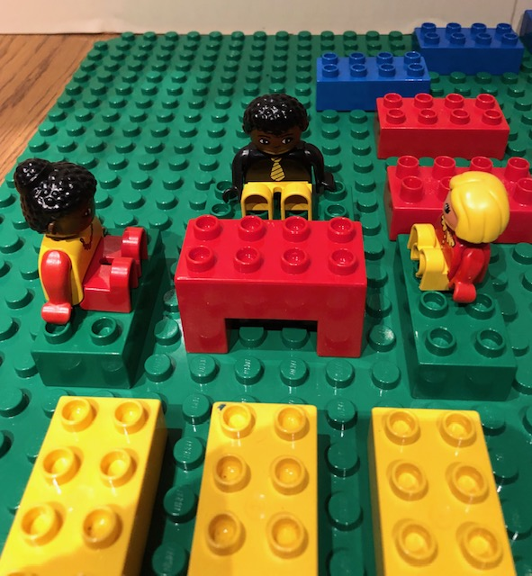
Move to the green bricks and share communion of bread and wine with each other. Make sure that it is the children who break the bread and distribute. Know yourself reconciled (made at peace) with God, each other and yourself. Take time to pause here and when you are ready, move on to the yellow bricks with Jesus and share where you will find joy in the coming week.
To finish say this prayer together say:
Risen Jesus, friend, companion and healer, as we walk the road in front of us, be by our side and never leave.
Amen

Slide 8
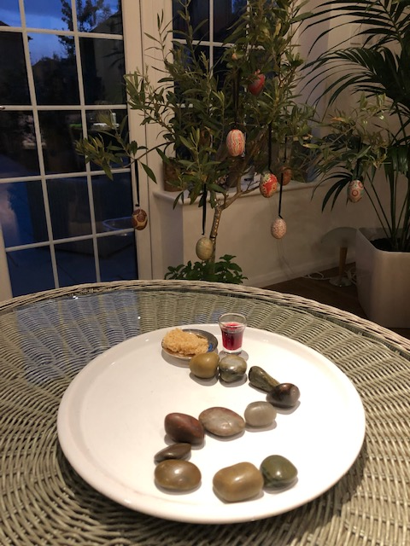
If you are not blessed with Duplo, take a plate, bread and wine and some stones, buttons or counters, anything that you can make a path with. On the plate make a trail towards the communion, as shown in the photograph. It doesn’t have to be a straight path. This is your own “Road to Emmaus,”
Cleopas and his friend, were heavy with grief and disappointment. They has experienced the crucifixion and 3 days later visited the tomb after the women reported sightings of Jesus, but they had seen no one. In their grief and disappointment, Jesus draws alongside them and listens.

Slide 9
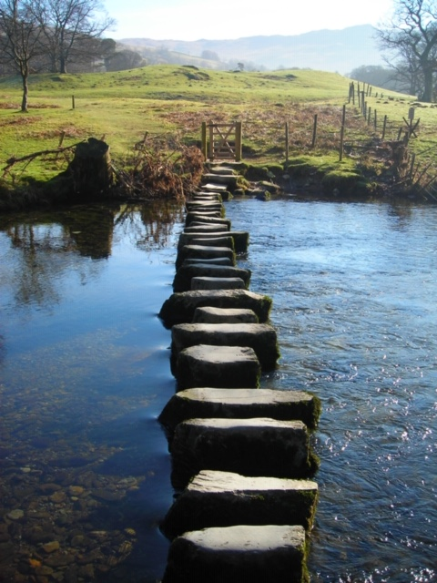
Begin by quietly saying this prayer by David Adam
Lord you are a present help in trouble.
Come revive, redeem, restore.
In our darkness come as light
In our sadness come as joy
In our troubles come as peace
In our weakness come as strength
Come Lord to our aid.
Come, revive, redeem, restore.
Open our eyes to your Presence
Open our minds to your grace
Open our lips to your praises
Open our hearts to your love
Open our lives to your healing
And be found walking at our side
Amen
(Tides and Seasons 1989)

Slide 10
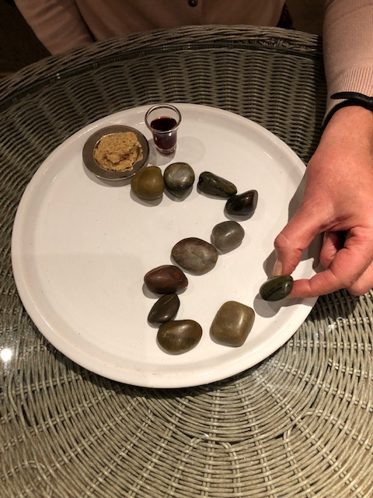
Take hold of the first stone and talk to Jesus about your first disappointment this week. The government have just announced another 3 weeks in lockdown, and though appreciating the need for this, you may feel disappointed. Move on to the next stone, each one represents a concern. You may be anxious for family, friends you cant see; worried about your job; your future. Tell Jesus how you feel, trying not to judge or rationalize the feelings.

Slide 11
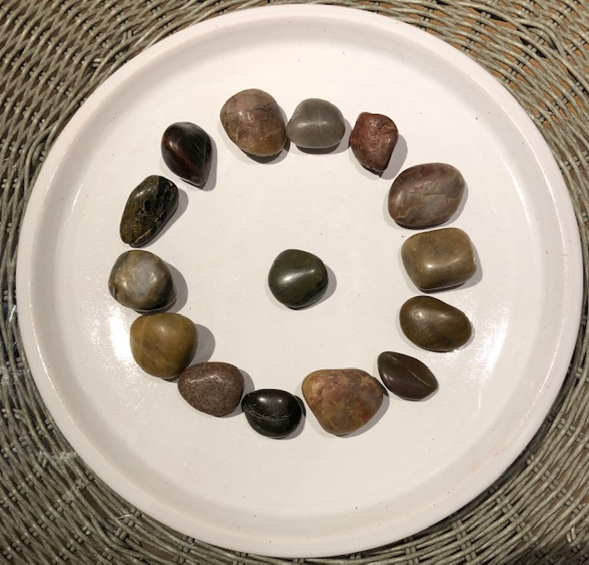
Move through the stones until you get half way and say this simple circling prayer by David Adam
Circle me O God
Keep peace within
Keep turmoil out
Circle me O God
Keep calm within
Keep storms without
Circle me O God
Keep strength within
Keep fear without
(The Edge of Glory 1985)

Slide 12
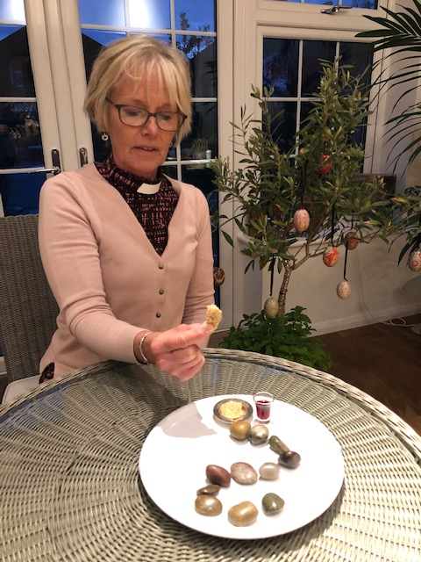
Move through the last of the stones, praying for the wider world
When you come to the bread and wine, give thanks for Jesus, who takes our isolated beads of knowledge and begins to restring them into a different sequence, revealing a new pattern and truth, that death is not the end, but the beginning of a fresh encounter with God and God’s love; that there is the hope of new life in all things and that our grief cane turn to joy.
Raise the bread and say
“I accept who I am, part of the risen body of Christ.”
Take the wine and say
“I am forgiven and I accept God’s grace.”

Slide 13
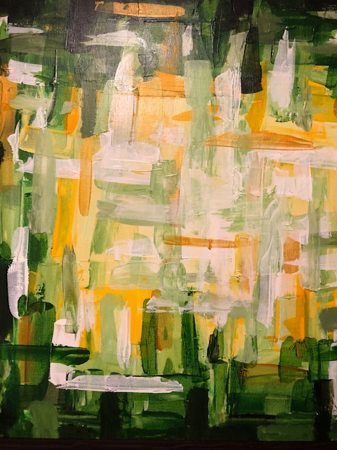
Finish with this joyful prayer by
David Adam
Lord, walk with me and increase
My zest for living
My vison of glory
My hearing of your call
My grasp of reality
My response to your love
My sensitivity to others
My gentleness to creation
My taste for wonder
My depth of faith
My wonder of belief
My love for you
Amen
(Power Lines 1992)

Slide 14
Amen

